Slide 1
Crossing a River
Professor Amit Pazgal

Slide 2
Four people want to cross a bridge that can only hold two at one time. It is pitch dark and they only have one flashlight. People must cross either alone or in pairs and must have the flashlight. Their walking speeds allow them to cross in 1, 2, 7, and 10 minutes, respectively.
If two people walk together, they walk at the slower speed. What is the minimum time for all to cross?

Slide 3
Crossing a River the Operations Way
Professor Amit Pazgal

Slide 4
Four people want to cross a bridge that can only hold two at one time. It is pitch dark and they only have one flashlight. People must cross either alone or in pairs and must have the flashlight. Their walking speeds allow them to cross in 1, 2, 7, and 10 minutes, respectively.
If two people walk together, they walk at the slower speed. What is the minimum time for all to cross?

Slide 6
Intuition: Use Your Best Asset
If the fastest guy is the one to shuttle the others back and forth, you use at least:
10 + 1 + 7+ 1 + 2 = 21 minutes
But it is false here! Why?

Slide 7
Solution:
1 and 2 cross | 2
1 returns | 1
7 and 10 cross | 10
2 returns | 2
1 and 2 cross | 2
17 minutes (20% better)

Slide 8
What if their walking speeds allow them to cross in 1, 5, 7, and 10 minutes, respectively?
“Best asset”:
10 + 1 + 7 + 1 + 5 = 24 minutes
“Load Balancing”
5 + 1 + 10 + 5 + 5 = 26 minutes

Slide 10
Introduction to Operations Management
Professor Amit Pazgal

Slide 11
The Old Definition(s)
Operations management is the administration of business practices to create the highest level of efficiency possible within an organization.
Operations management is concerned with converting materials and labor into goods and services as efficiently as possible to maximize the profit of an organization.

Slide 12
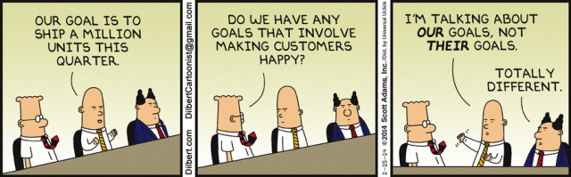

Slide 13
New Accepted Definition
Operations management (OM) is defined as the design, operation, and improvement of the systems that create and deliver the firm’s primary value.
It is valid for all value propositions (goods and services).

Slide 14
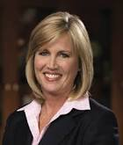
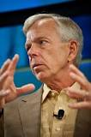
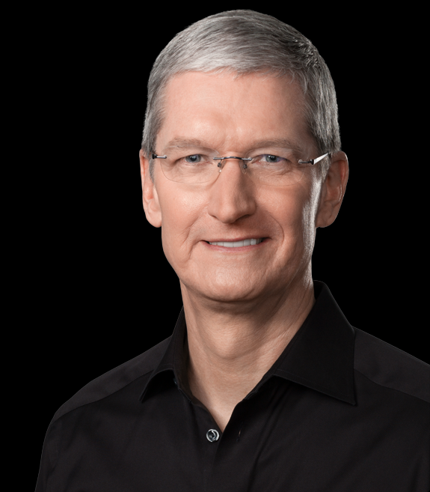
Why Operations?
According to Forbes: 50% of Fortune 500 CEOs were promoted from a COO position.
James Quincey, Coca-Cola CEO, was the COO until May 2017
Brian Crutcher, Texas Instruments CEO, was COO until June 2018
75% came from an operating role.
Contrary to common belief:
“Although over 30% of CEOs have strong financial background, executives very rarely move directly from a finance role to the CEO position”
Nicholson
McAdam
Cook
Notes:
Cook Apple, pamela Nicholson –enterprise rent a car Lowel mcadam Verizon

Slide 15
Chief Operating Officer
There is no single agreed-upon description of what the job entails, or even what it’s called.
Often, companies turn responsibility for all areas of operations over to the COO—this typically includes production, marketing and sales, and research and development. [HR?]
In some firms, the job is to be Mr. Inside to the CEO’s Mr. Outside. In others, the mission is focused on a specific business need.
HBR (2006)

Slide 16
The Consultancy Services Market
Percentage of world revenues of 40 largest firms
Operations and process management 31%
Source: Nigel Slack and Michael Lewis

Slide 17
Options for Increasing Contribution
 |  | Marketing Option | Finance/Accounting Option | OM Option
 | Current | Increase Sales Revenue 50% | Reduce Finance Costs 50% | Reduce Production Costs 20%
Sales | $100,000 | $150,000 | $100,000 | $100,000
Cost of Goods | –80,000 | –120,000 | –80,000 | –64,000
Gross Margin | 20,000 | 30,000 | 20,000 | 36,000
Finance Costs | –6,000 | –6,000 | –3,000 | –6,000
Subtotal | 14,000 | 24,000 | 17,000 | 30,000
Taxes at 25% | –3,500 | –6,000 | –4,250 | –7,500
Contribution | $ 10,500 | $ 18,000 | $ 12,750 | $ 22,500

Slide 19
Areas of Operations Management Covered in This Course
Professor Amit Pazgal

Slide 20
Operations Management: Discipline
Operations management has several broad areas of interest
Process analysis and design
Supply chain management
Process improvement and quality
We will cover each with theoretical lectures, exercises, and lectures.
An area that we will not cover at all relates to project management.

Slide 21
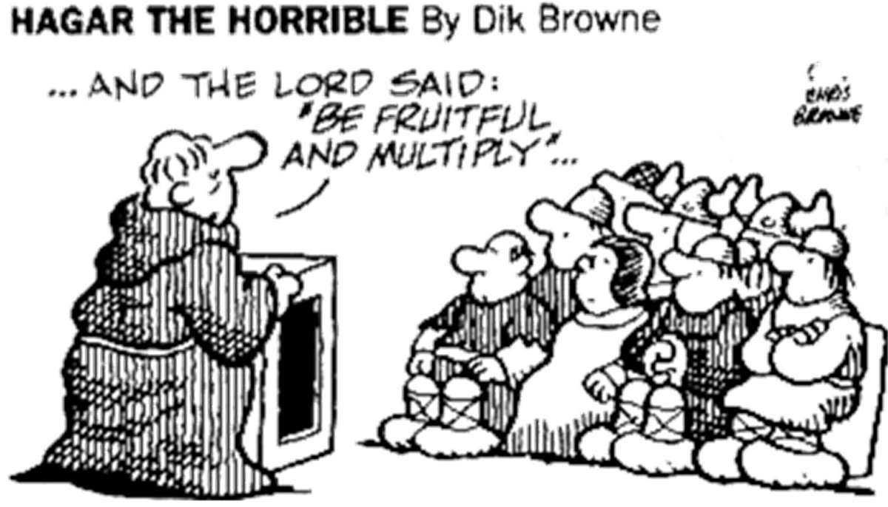
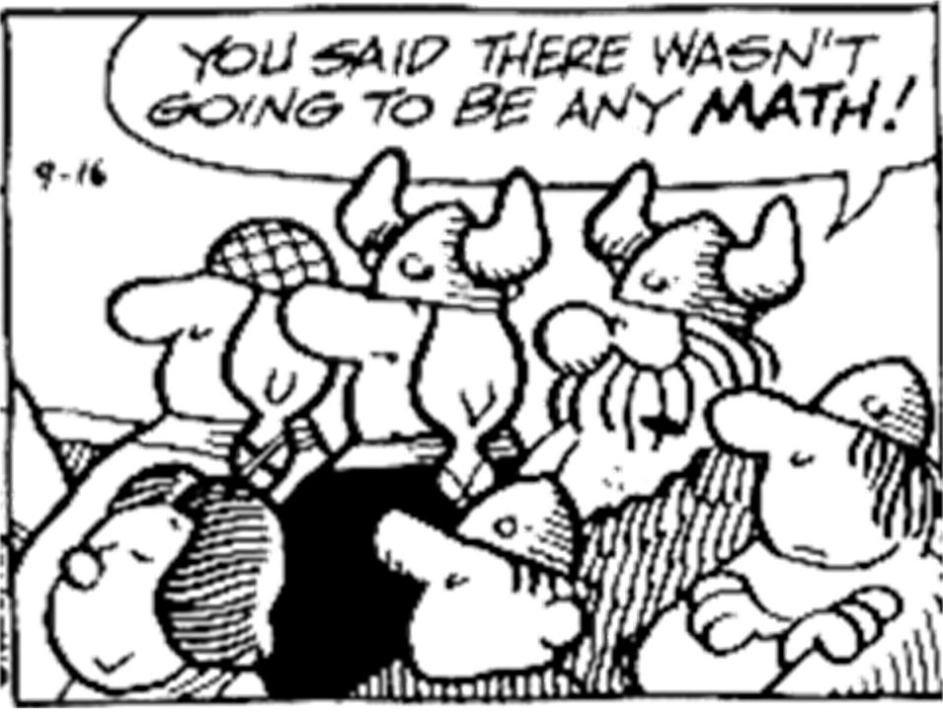
Disclaimer I

Slide 22
Disclaimer II

Slide 23
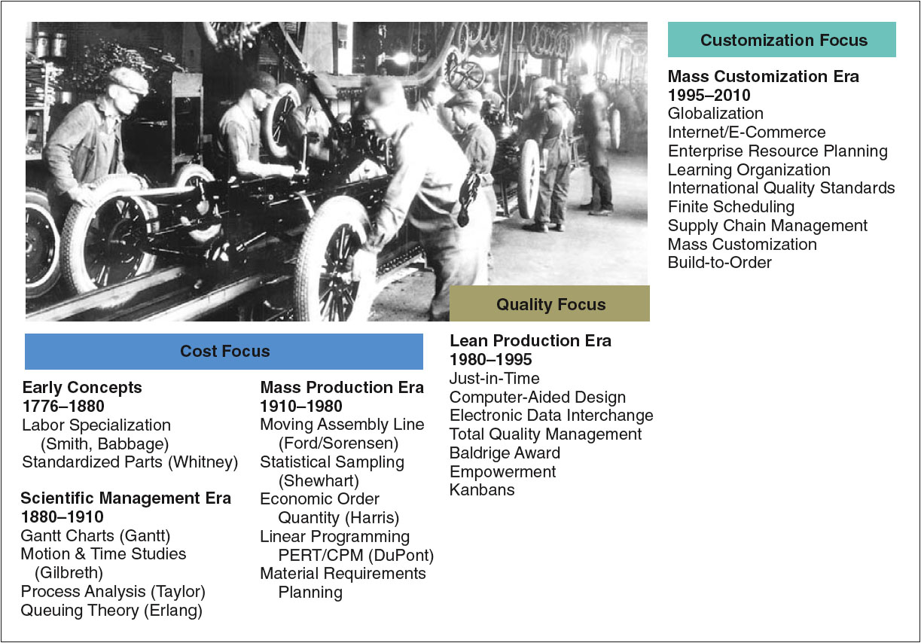


Significant Events in OM

Slide 25
Mass Customization of M&M
Professor Amit Pazgal

Slide 26
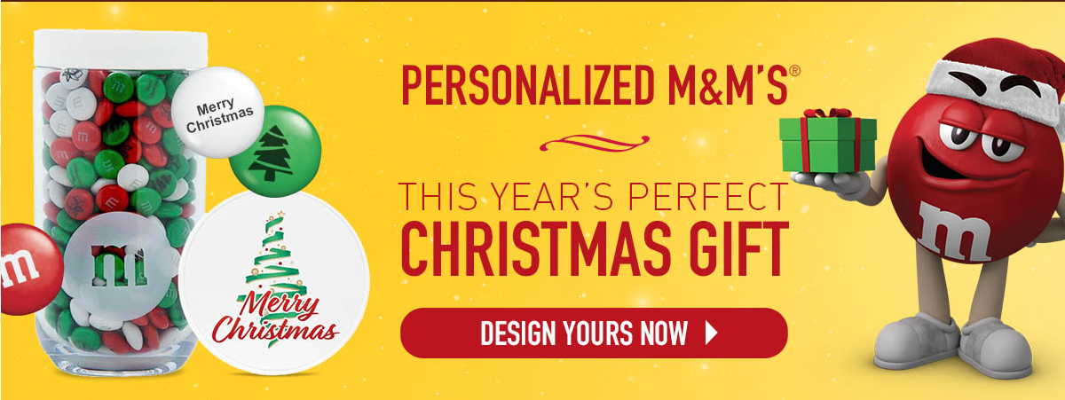
M&M

Slide 28
Operations Is All About Trade-Offs
Professor Amit Pazgal

Slide 29
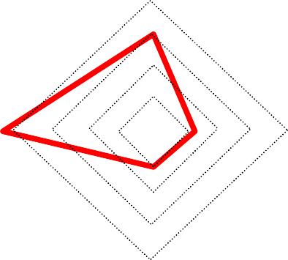
What Is Operations Management?
Time
Quality
Flexibility/variety
Cost
Choosing the right combination!

Slide 30
OM: All About Trade-Offs
Cost
Efficiency
Measured by:
Cost per unit
Utilization
Quality
Product quality (how good?) => price
Process quality (as good as promised?) => defect rate
Variety/flexibility
Customer heterogeneity
Measured by:
Number of options
Flexibility/set-ups
Make-to-order
Time
Responsiveness to demand
Measured by:
Customer lead time
Flow time

Slide 31
IRS… (According to WSJ)
In 2015, taxpayers trying to reach the IRS on a toll-free line had a 38% chance of reaching a person—after waiting an average of more than 30 minutes.
Congress wanted in 2016 that about 60% of calls would go through and that wait times would decline to under 20 minutes.
So Congress allocated $290 million for taxpayer services and hiring 1,000 more people.

Slide 32


Example: Help Making Operational Trade-Offs
Responsiveness
High
Very short waiting times,
comes at the expense of
frequent operator idle time
Trade-off
Long waiting times, yet operators are almost fully utilized
Low
Low labor
productivity
High labor
productivity
Labor productivity
(e.g., $/call)
Example: call center of Deutsche Bundesbahn
Objective: 80% of incoming calls wait less than 20 seconds
Starting point: 30% of incoming calls wait less than 20 seconds
OM helps: provides tools to support strategic trade-offs

Slide 33
Example II: Overcome Inefficiencies
Responsiveness
Current frontier
in the industry
High
Competitor A
Eliminate inefficiencies
Competitor C
Low
Competitor B
Low labor
productivity
High labor
productivity
Labor productivity
(e.g., $/call)
Example
Benchmarking shows the pattern above
Don’t just manage the current system—change it!
OM helps: provides tools to identify and eliminate inefficiencies

Slide 34
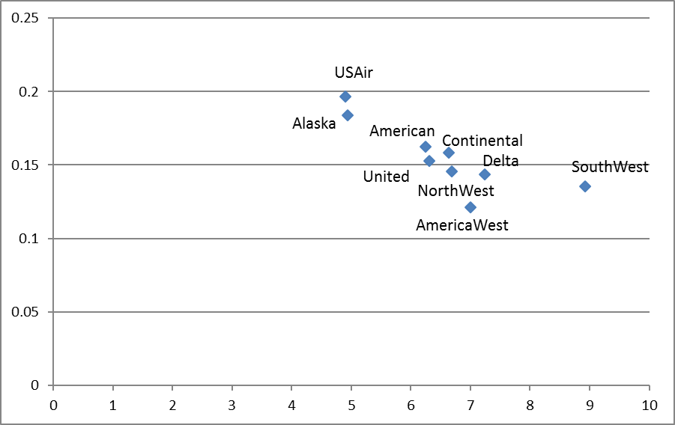
Airlines
Two common parameters:
Passenger miles per $ operating expense
Revenue per passenger mile (yield)
Yield
PM/OE
2000 Data

Slide 35
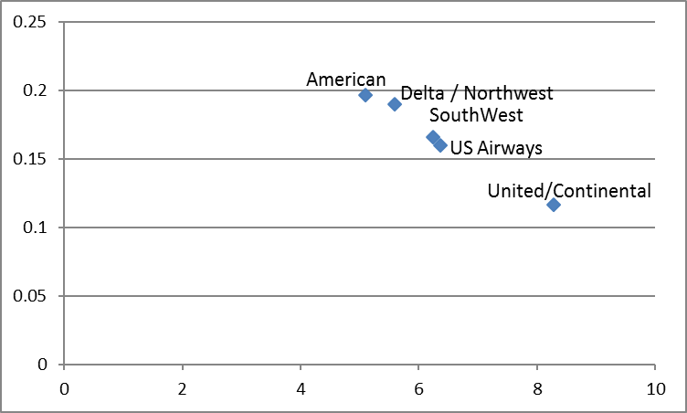

Airlines
2000 Data
2012 Data
Yield

Slide 36
Example III: Evaluate Proposed Technologies
Responsiveness
High
Redesign process
Current frontier
In the industry
New frontier
Low
Low labor
productivity
High labor
productivity
Labor productivity
(e.g., $/call)
Example
What will happen if we develop/purchase technology X?
Better technologies are always (?) nice to have, but will they pay?
OM helps: evaluates system designs before they occur

Slide 38
Trade-Off Indian Hospital
Professor Amit Pazgal

Slide 39
Focus and the Frontier: Indian Hospital
Responsiveness
Operations frontier
Where does Quality stand?
Indian hospital
Cost efficiency

Slide 40
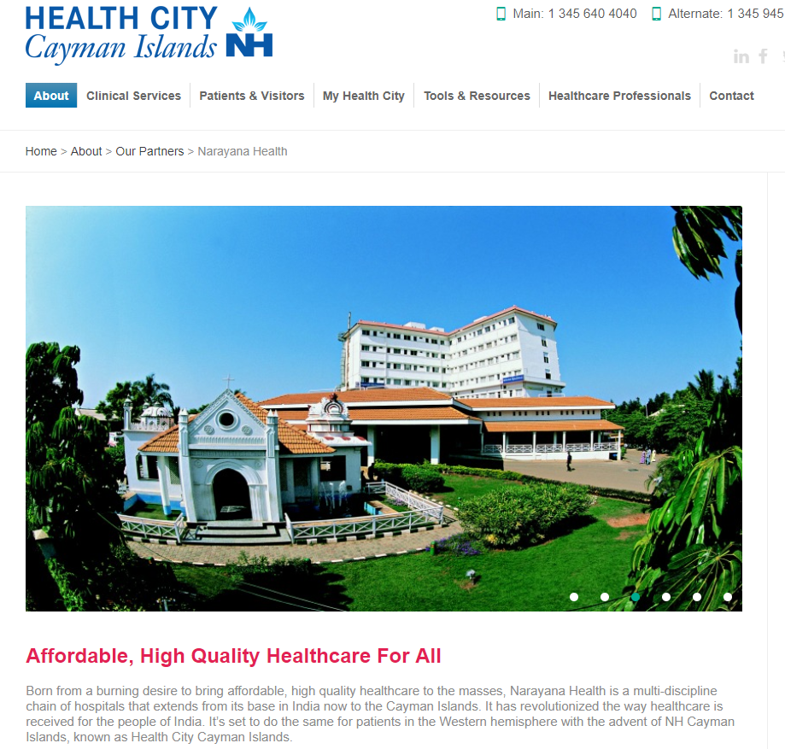
Indian Hospital: Cayman Islands

Slide 42
Pareto Principle
Professor Amit Pazgal

Slide 43
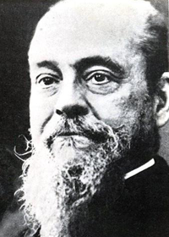
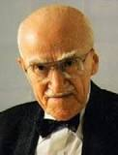
Pareto Phenomenon
A few factors account for a high percentage of the occurrence of some event(s).
80/20 rule
80% of problems are caused by 20% of the activities.
80% of revenue comes from 20% of customers (generated by 20% of workers).
How do we identify the vital few?

Slide 44
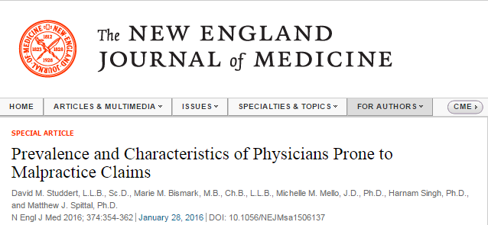
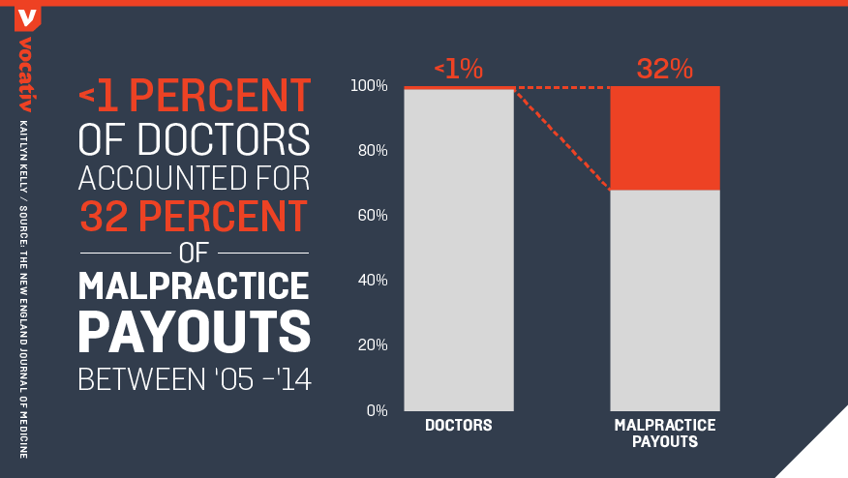
A profile of the physician most likely to lose malpractice lawsuits—he is male, more than 35 years old, in internal medicine or general surgery and, most importantly, this isn’t his first lawsuit.

Slide 45
True for Customers as Well (80/20 Rule)
U.S. Domestic Beer
Sales
High
75%
9%
Medium
12%
22%
Low
10%
3%
No Profit
69%
0%

Slide 47
Perspectives on Operations Strategy
Professor Amit Pazgal

Slide 48
Operations Strategy Is…
“… the total pattern of decisions…
… that shape the long-term capabilities…
… of any type of operation...
… and their contribution to overall strategy…
… through the on-going reconciliation of market requirements and operations resources…
… so as to achieve a sustainable fit between the two…
… whilst managing the risks of misalignment.”
Black & Lewis

Slide 49
Operations Management vs. Operations strategy
 | Management | Strategy
Timescale | Short term | Long term
Level of Analysis | Micro | Macro
Level of Aggregation | Detailed | Aggregated
Level of Abstraction | Concrete | More philosophical

Slide 50
The Four Perspectives on Operations Strategy
Top-down
Should interpret higher-level strategy
Operations resources
Should build operations capabilities
Market requirements
Should satisfy the organization’s markets
Operations Strategy
Bottom-up
Should learn from day-to-day experiences

Slide 51
Operations resources
Market requirements
What you have
in terms of operations capabilities
What you do
to maintain your capabilities and satisfy markets
What you want
from your operations to help you “compete”
What you need
to “compete” in the market
Strategic reconciliation

Slide 52

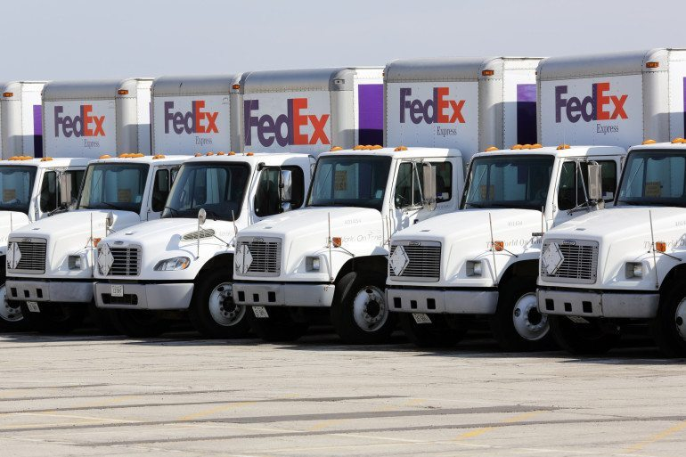

Strategy: UPS vs. FedEx
X

Slide 53
Linking the Strategy and Process
Existing
Desired
Measures
Feasible
business strategies
Desired
business strategy
Product attributes
P, T, Q, V
Strategy gap?
Existing
capabilities
Capability gap?
Desired
capabilities
Product attribute (external) | Process competency (internal)
Price | Cost
Response time | Flow time
Variety | Flexibility
Quality | Quality
Operations strategy
Marketing, …,
financial strategy
Process attributes
C, T, Q, Flex
Operational structure: processes and infrastructure
Process gap?
Desired operational structure:
processes and infrastructure
Notes:
Price Quality Variety

Slide 55
Walmart Example
Professor Amit Pazgal

Slide 56
Walmart
Corporate strategy
(Gain competitive advantage by) providing customers access to quality goods, when and where needed, at competitive prices
Operations Structure
Supply chain/DCs
Cross docking
Responsive transportation system
EDI
Satellite
Focused locations
Operations Strategy
Short flow times/high turnover
Low inventory levels
Information system

Slide 57
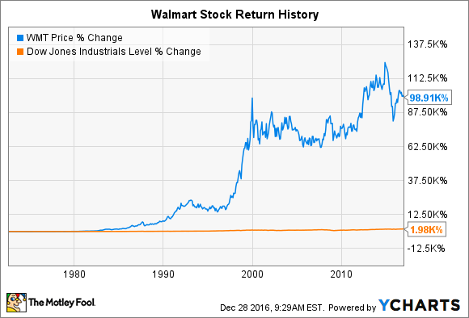
Walmart
Improved targeting of products to markets
Sales per square foot increased from $102 in 1985 to $140 in 1991 to $425 in 2009
It was $431 in 2017
Target at $276; Macy’s at $150; Apple at $5079

Slide 58
Inventory Turns in Retailing and Its Link to Inventory Costs
 | Home Depot (1/2017) | Target (1/2017) | Walmart (1/2017)
Net Sales (million $) | $94,595 | $69,495 | $485,873
Cost of sales | $62,282 | $48,872 | $361,256
Net Income | $7,957 | $2,737 | $14,293
Inventories | $11,809 | $8,601 | $43,046
Inventory Turns
Months of Inventory
If Walmart carried the same months of inventory as HD, its inventories would be
Notes:
@MBPF: Principles of Operations Management

Slide 59
Inventory Turns in Retailing and Its Link to Inventory Costs
 | Home Depot (1/2017) | Target (1/2017) | Walmart (1/2017)
Net Sales (million $) | $94,595 | $69,495 | $485,873
Cost of sales | $62,282 | $48,872 | $361,256
Net Income | $7,957 | $2,737 | $14,293
Inventories | $11,809 | $8,601 | $43,046
Inventory Turns | 5.27 | 5.68 | 8.40
Months of Inventory | 2.28 | 2.11 | 1.43
If Walmart carried the same months of inventory as HD, its inventories would be
I = $68.6B
This would tie up about $25 billion extra in inventory.
Notes:
MOI: 11809/62282 *12 = 2.275 months = 5.27 times/year
43046/361256*12 = 1.43 months = 8.7 times/year
If Wal-Mart carried 2.27 months of inventory,
I = RT 361256*11809/62282= $68496
it would have about $39 billion extra in inventory
@MBPF: Principles of Operations Management

Slide 60
Slotting Allowances
Lump-sum, up-front payments from a manufacturer or producer to a retailer to have a [new] product carried by the retailer and placed on its shelves
A variant sometimes known as “pay-to-stay” fees, paid by manufacturers to keep existing products on retailers’ shelves
The practice is common for certain products in supermarkets but also increasingly occurs in computer software, compact discs, books, magazines, apparel, and over-the-counter drugs

Slide 61
Slotting: Potential Benefits
Signaling likely product success
Statement of confidence by the manufacturer
Shifting risk of product failure
Compensates retailers for real costs and risks
Shifts risk to firm best able to control it with promotions, consumer research, and so on
Gives retailers an incentive to try new products and new manufacturers
May be an efficient mechanism for shelf-space allocation
Most retailers use it, but Walmart stores don’t!

Slide 62
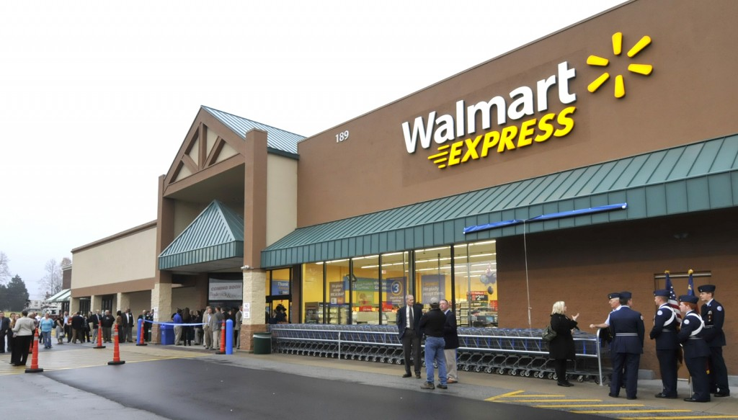
Walmart Ended Its Express Concept in 2016 and Closed 269 Stores

Slide 64
Operations Strategy Matrix
Professor Amit Pazgal

Slide 65
Toward an Operations Strategy Matrix
Need to reconcile performance objectives (come from market requirements) with operation tasks or decision areas (resource usage)
Performance objectives | Decision areas
Quality | Capacity
Speed/time | Supply network
Flexibility | Process technology
Cost | Development and organization
Dependability

Slide 66
Performance Objectives: Valve Manufacturer
Quality: percentage of products conforming to specifications
Speed: lead time enquiry to quote or order to delivery
Flexibility: range of possible sizes, gouges, coating
Cost: price of products, discounts, payment terms
Dependability: percentage of deliveries on time in full

Slide 67
Decomposing the Ratio Profit/Total Assets to Derive the Four Strategic Decision Areas of Operations Strategy
ROA =
Profit
=
Output
×
Profit
Total assets
Total assets
Output
Output
Output
Fixed assets
Capacity
Profit
Revenue
−
Cost
Total assets
=
×
×
=
Capacity
Total assets
Fixed assets
Output
Output
Output
Utilization
Working capital
Productivity of fixed assets
Average revenue
Average cost
Operations strategy decision areas
Capacity
Supply network
Process technology
Development and organization
Slack & Lewis

Slide 68
The Operations Strategy Matrix
Resource usage
Performance objectives
Quality
Speed
Flexibility
Operations strategy
Market competitiveness
Cost
Dependability
Supply network
Process technology
Development and organization
Capacity
Decision areas

